Slide 1
Exploratory Data Analysis (EDA) for Real Estate Pricing: Unveiling the Dynamics of House Valuation in a Dynamic Market
Created by: Divya Sharma
Github URL:

Slide 2
Problem statment
In the dynamic landscape of the residential real estate market, determining an optimal and competitive price for a house is a multifaceted challenge. As a key member of the analytics team in a leading real estate company, your task is to conduct a comprehensive analysis to identify and understand the myriad variables that significantly influence house prices. By leveraging advanced data analytics techniques and visualization tools, your goal is to uncover patterns, correlations, and trends within the dataset, enabling the company to make informed decisions and strategically position properties for better business opportunities.

Slide 3
Feature Engineering and Size Impact:
Engineer new features capturing relevant information such as price per square foot or the age of the property.
Visualize the relationship between key features like bedrooms, bathrooms, and square footage with house prices, determining their impact on valuation.
Market Trends and Historical Pricing:
Analyze historical pricing trends over time, considering external factors like economic indicators.
Create time-series visualizations to understand how market trends influence house prices, helping predict future valuation trends.
Customer Preferences and Amenities:
Explore the influence of customer preferences and amenities on house prices.
Utilize sentiment analysis on customer feedback to gauge the perceived value of specific features.
Apply clustering algorithms to group houses with similar amenity profiles, revealing distinct market segments and pricing strategies.

Slide 4
Data Exploration
There are 1460 rows and 81 columns in the data.
In our data we found there was around 93% missing data for the column Alley and 59.73 in MasVnrType columns, hence we will drop the column.
As we found less missing values in GarageYrBlt, Electrical, instead of dropping the data we performed null imputation so will fill if data is object we applied mode as a metric and for numerical data will apply mean method.

Slide 5
Exploratory Data Analysis

Slide 6
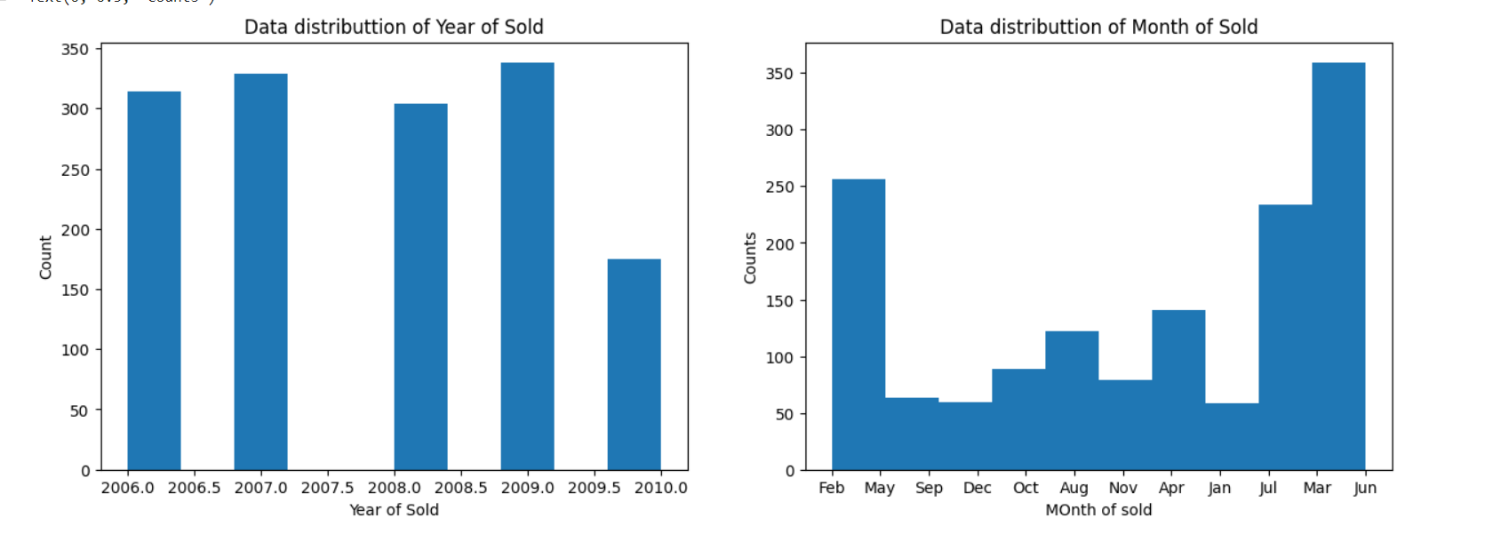
Data distribution of sale by year and month

Slide 7
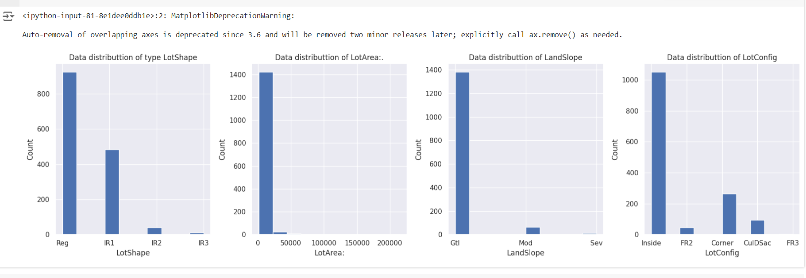
Distribution of Lots type

Slide 8
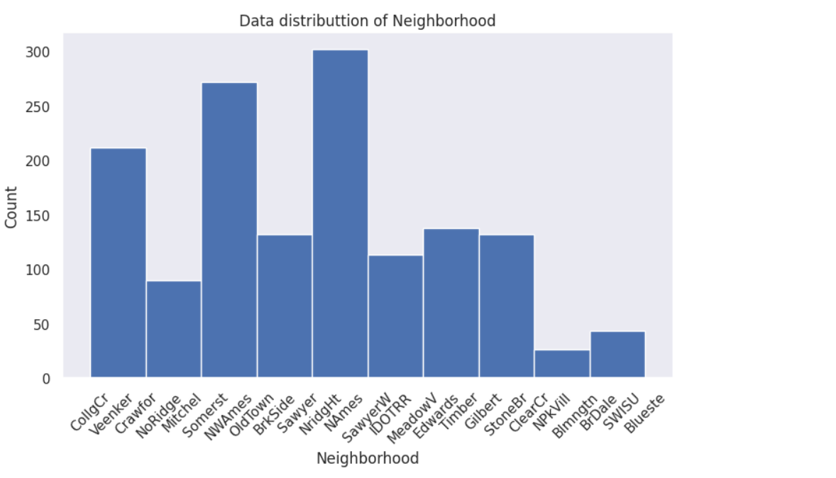
Data distribution of Neighborhood

Slide 9
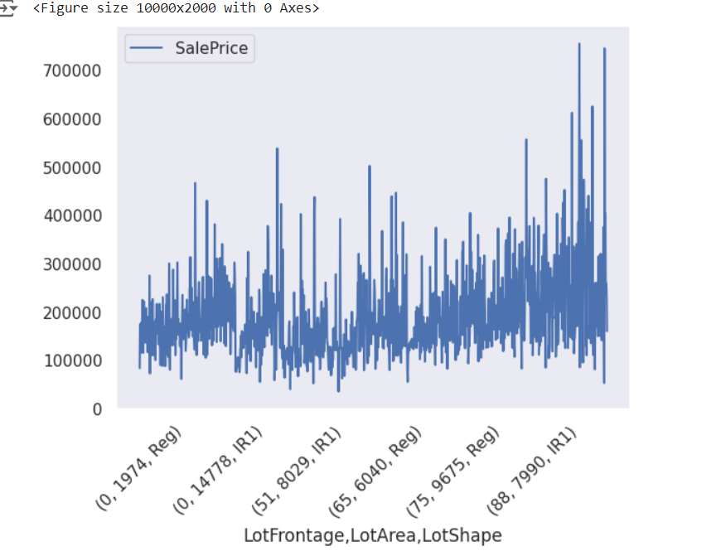
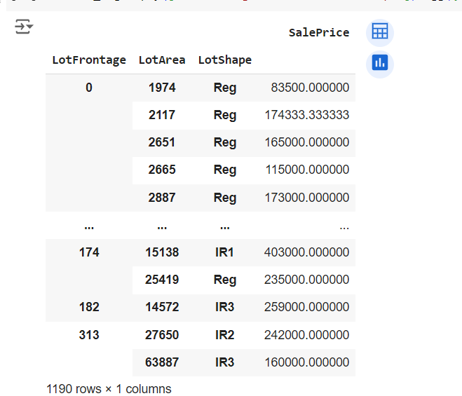
SalePrice Vs Lotfrontage,LotArea,Lotshape

Slide 10
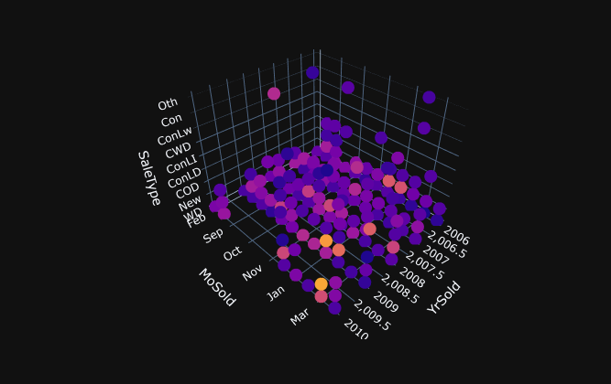

Here is the 3D plot of data by year month and type v/s Sale price

Slide 11
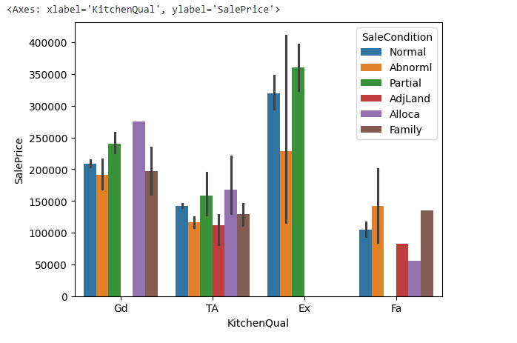
Distributton of price and condtion data of Kitchen quality

Slide 12
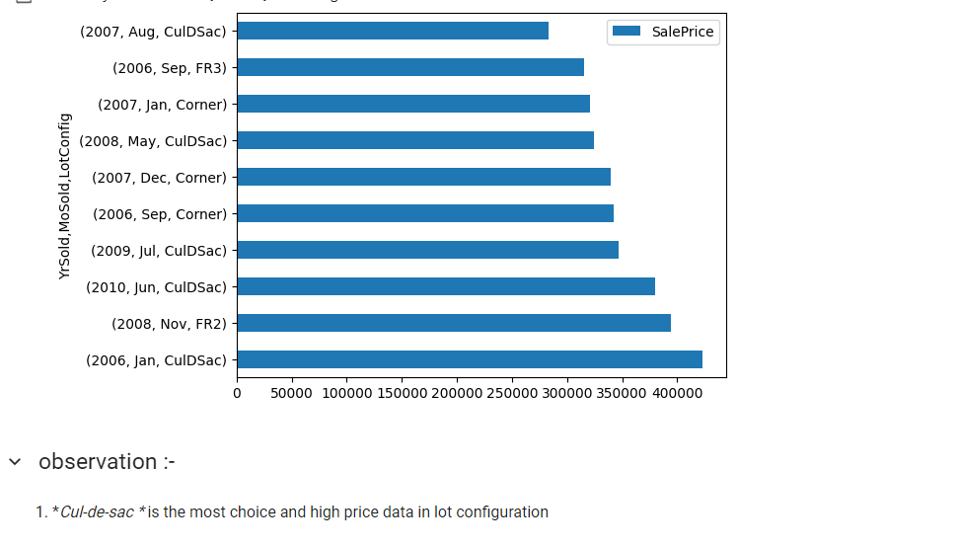

Slide 13
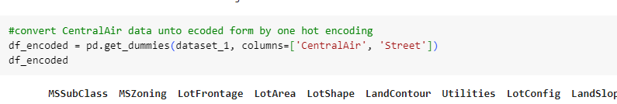
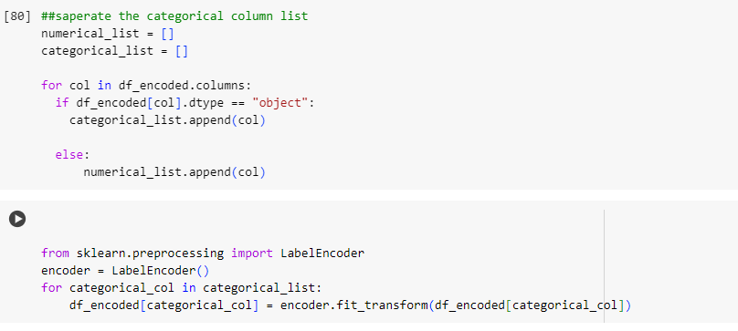
Encoding of data
Encoded all the data into numerical format

Slide 14
Thanks

